Slide 1


Summer Training Briefing
243 Ogopogo Royal Canadian Air Cadets
Capt. Solomonides/Lt Rojas
CO@243Air.com /AdminO@243air.com
14 June 2023

Slide 2

Congratulations!

Slide 3

Agenda
CTC Locations
CAP and Location
Movement Orders
  Getting there
  Coming home
Joining Instructions Overview
CTC Life
Summer Contact Officer
Questions

Slide 4
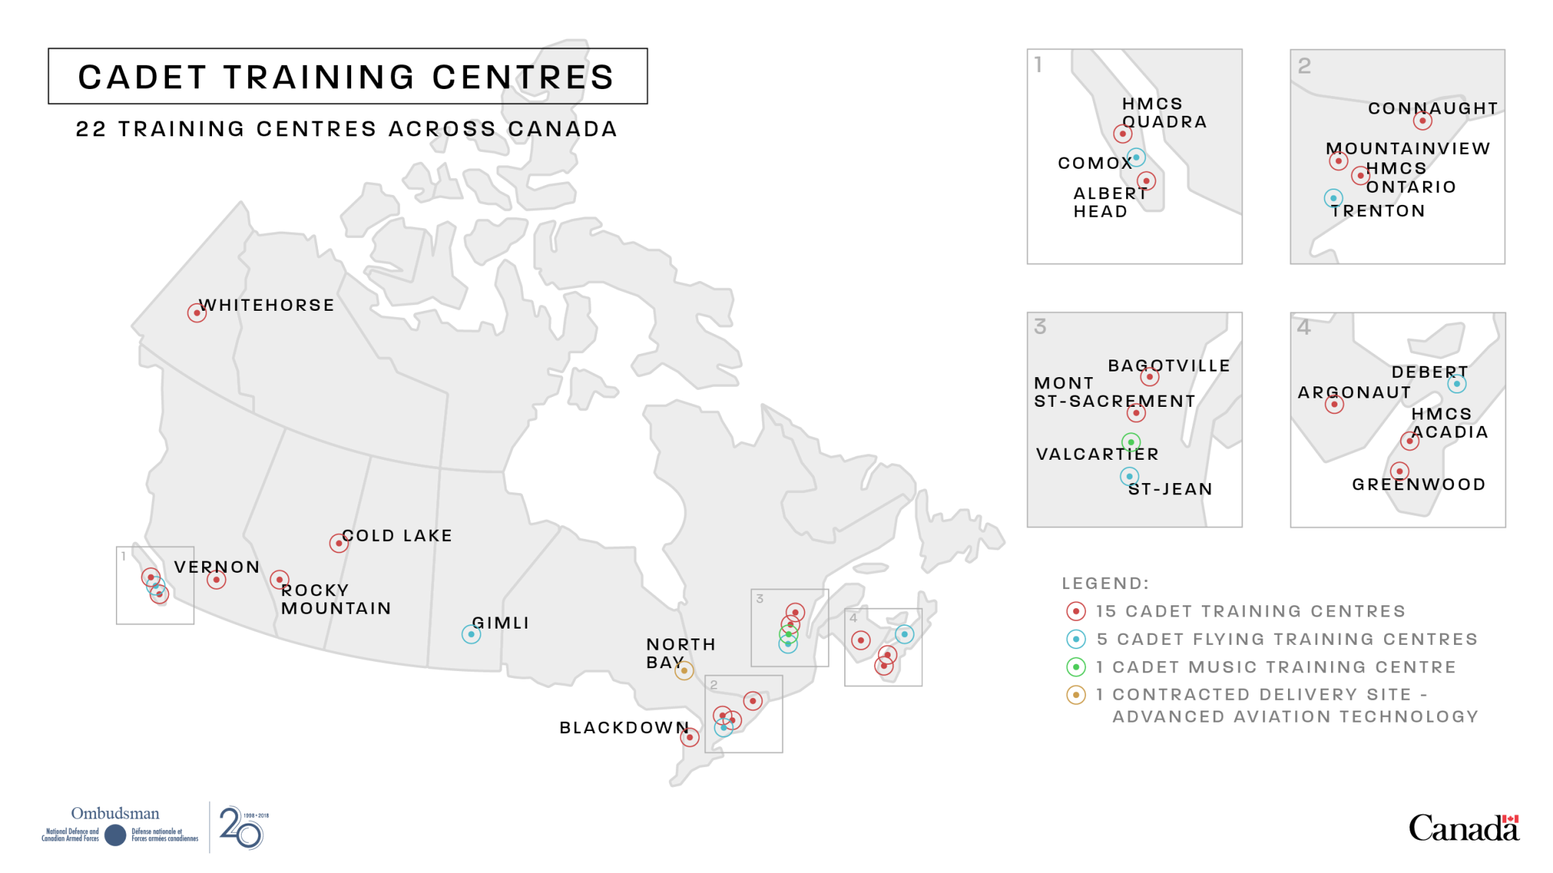

CTC Locations
Vernon

Slide 5




Vernon CTC
3 Cadets
On Hwy 97 into Vernon
Vernon Cadet Training Centre
Rank, Full Name, Initial
3100 15th Ave, Building B3
Vernon, BC
V1T 0A6
250-549-5800 or 1-888-530-2288

Slide 6
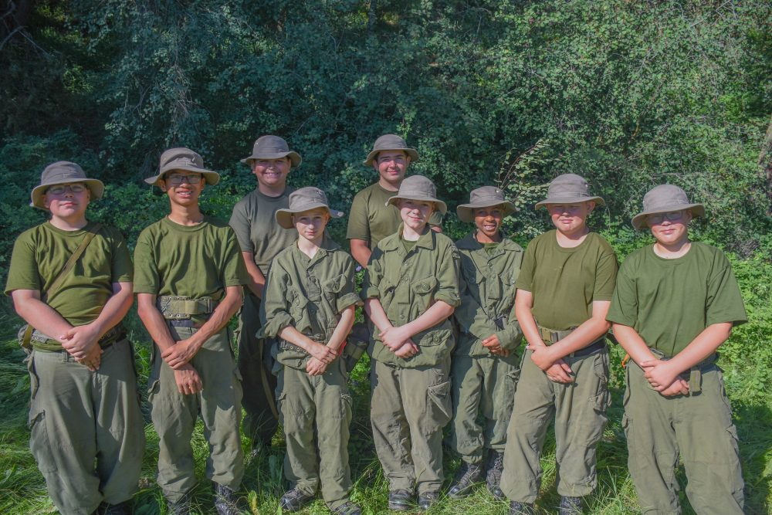
Summer C.A.P
13 Cadets
Summer CAP Location at the Vernon CTC
There should be a central location and timings for a bus pick up and drop off .

Slide 7
What does a CAP day look like?
CAP1 (Yr 1 Cadets) 1 Week
Monday - Friday
8:30-9:00 Cadet Drop Off or bus pick up Monday
9:00-10:40 Activities
10:40-11:00 Break
11:00-12:30 Activities
12:30-1:20 Lunch
1:20-4:10 Activities
4:10-4:30 End of Day Routine
4:30-5:00 Cadet Pick Up or bus drop off Friday
CAP2 (Yr 2 Cadets) 2 Weeks
Monday – Thursday / Tuesday - Friday
8:30-9:00 Cadet Drop Off
9:15-10:40 Activities
10:40-11:00 Break
11:00-12:30 Activities
12:30-1:20 Lunch
1:20-4:10 Activities
4:10-4:30 End of Day Routine
4:30-5:00 Cadet Pick Up
Friday – Monday FTX
Vernon CTC

Slide 8
Tell Me More…
CAP1
Meals
Lunches provided daily
Fresh Rations + 1 MRE Meal
Daily snacks provided
Dress
Appropriate civilian attire and/or FTU’s
*detailed lists provided in JIs
Equipment
All training support materials and activity equipment provided
CAP2
Meals
Lunches provided daily (Fresh Rations)
Breakfast/Lunch/Dinner provided during FTX (MREs)
Daily snacks provided
Dress
Appropriate civilian attire and/or FTUs/STUs*detailed lists provided in JIs
Equipment
All training support materials, activity and FTX equipment provided

Slide 9
Movement Orders
How to get there & come home
To Follow via Email

Slide 10
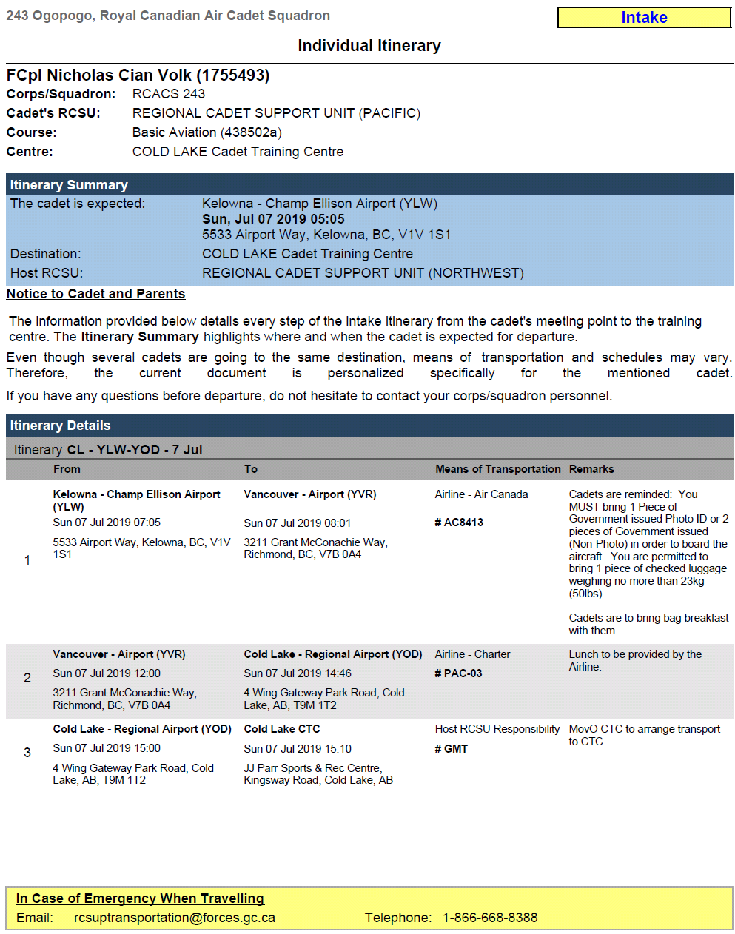
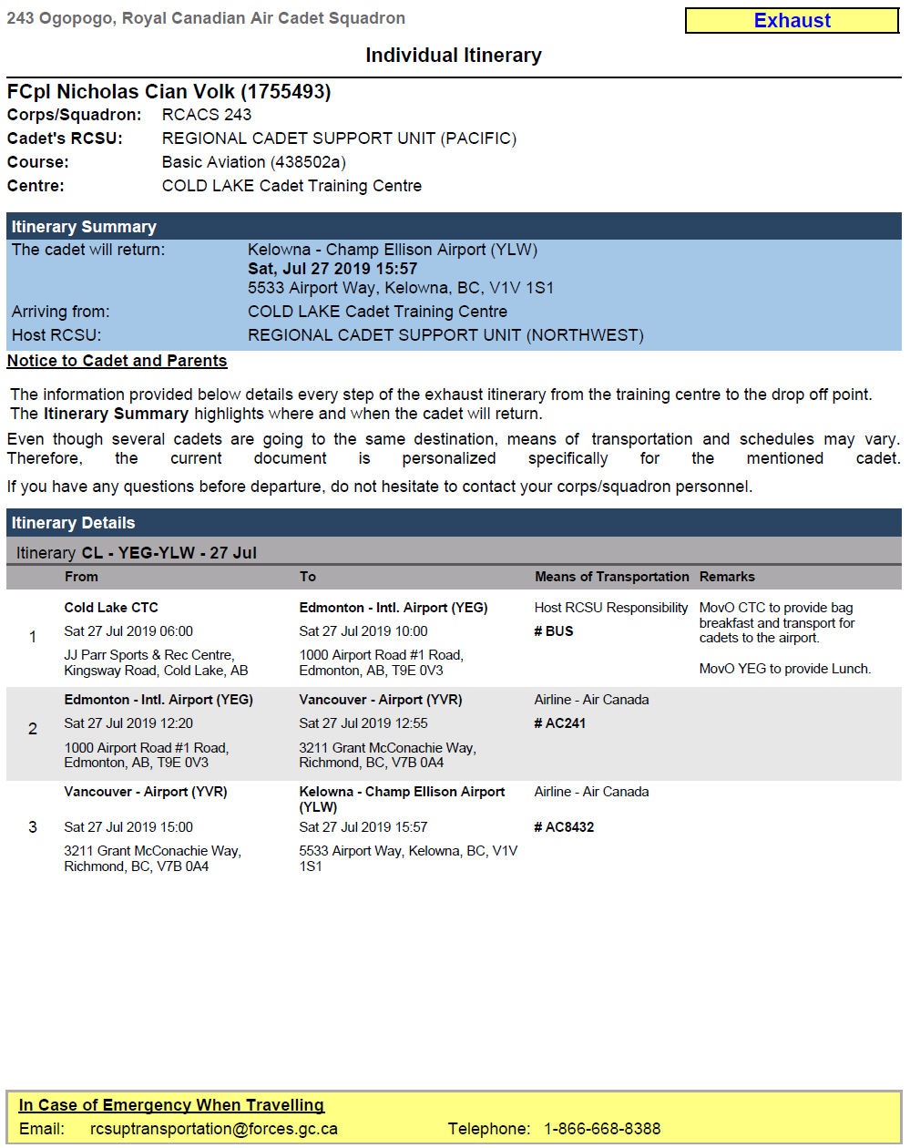
Movement Orders
Intake (getting there)
Exhaust (coming home)
Name
Name
Baggage requirements
Notes:
1 copy – With Cadet
1 copy – home with parents
1 copy – with squadron
If any errors – Contact Summer Contact Officer ASAP!
If any emergency, contact RCSU Movements – 1866-668-8388

Slide 11




In case of emergency while travelling
RCSU (PAC) Movements Number
RCSUPTransportation@forces.gc.ca
1-866-668-8388
243 Ogopogo Summer Contact Officer
Lt Rojas ,D - admino@243air.com
250-826-7471

Slide 12
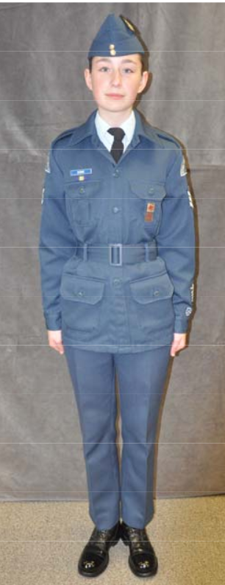
How to Travel
What to travel with
Government issued ID
  Passport, BCID, BCDL
  Name must match all documents
Movement Order (intake / exhaust)
Put these all in a zip lock bag!
What to wear:
What time to arrive
Uniform FTU (CAP Only) or C2 CTC

Slide 13
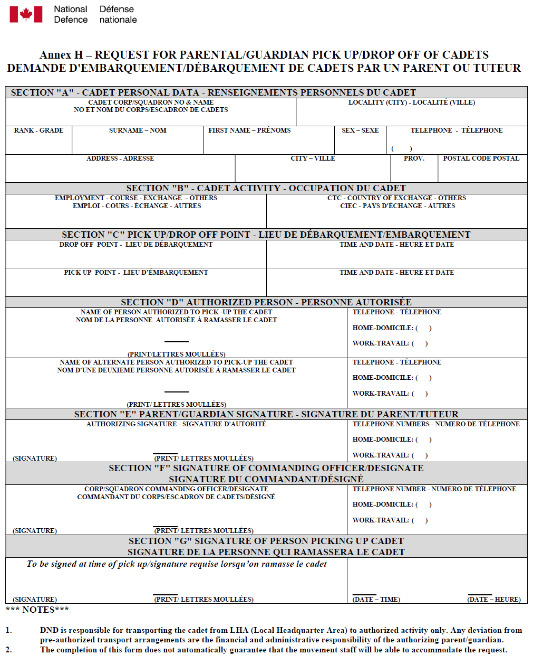
Request for Parental/Guardian Pick up/Drop Off of Cadets
Only if you want to pick-up your Cadet at end of course
Completed forms to Commanding Officer
  CO@243air.com
  In person
Need to be in ASAP!

Slide 14
Joining Instructions
CTC Bible

Slide 15

Joining Instructions
What it Covers
Code of Conduct
What to (and NOT) pack
Graduation dates
Accommodations
Contact information
Medical & Dental
Some Courses Hybrid
READ THIS IN DETAIL
243air.com for all JIs

Slide 16

Baggage / Packing
General Guidelines
Special Notes
Kit Inspection
Identification (name, colour)
No garbage bags or bags with broken zippers
No:
  Ironing boards
  Breakables
  Aerosol cans without pressure release
  Prohibited / Restricted items
Combination Locks x 2
Sandals
All uniform parts
Appropriate civilian attire – minimal
Tilly hat if you have one.
Shoes (runners) x 2
LABEL EVERYTHING!
(In sharpie)
CATO 12-50 – Searches & Inspections of Cadets
Prohibited / restricted items
Notes:
No financial responsibility of any of the supplies

Slide 17
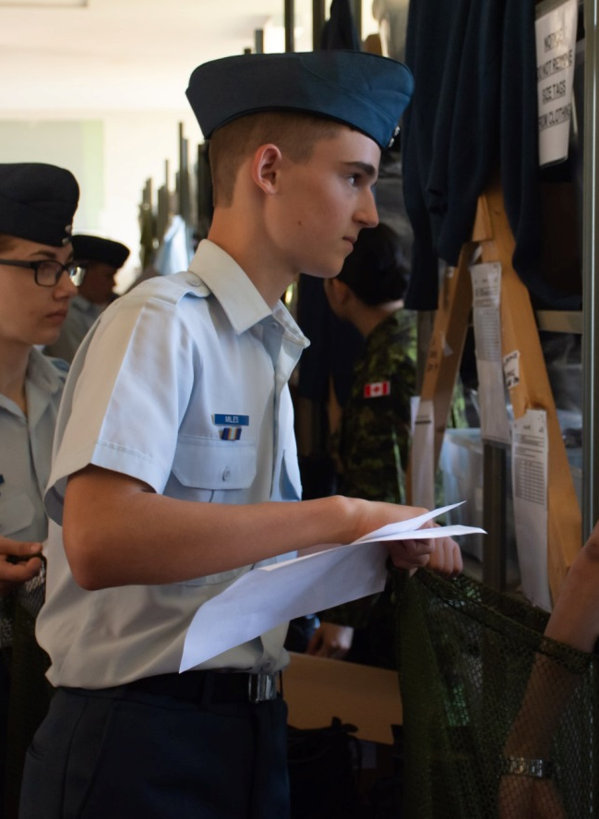
Joining Instructions
In-Routine (Once you arrive)
Offer of Participation (Cadet, Parent, Squadron)
If you don’t have a copy of your offer of Participation, please ask our administration officer
Medical
  Provincial Health Card (or copy)
  Eyeglasses & prescription (as needed)
  Blister pack & medication/OTC form (as needed)
Code of Conduct - signed
Movement Orders (Cadet, Parent, Squadron)
Leave pass (as needed)
Put these all in a large zip lock bag!

Slide 18
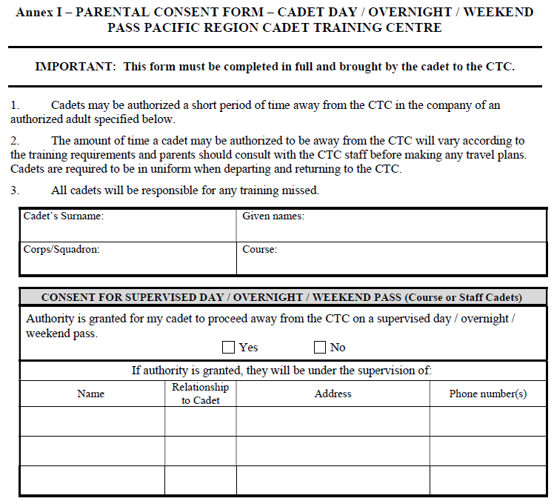

Visits / Leave Pass
Weekend leave & non-training hours
  Only release cadets to authorized adults on the form
  Example: Grandpa/grandma want to visit

Slide 19
CTC Life
What my summer experience will be like

Slide 20
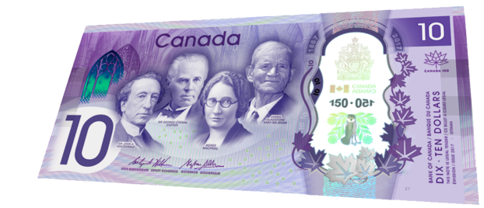

CTC Life
Banking
Contact Home
No ATM on base
Training Bonus ($10/Training day)
  $60/week max for CTC cadets only.
  Must have a bank account in your name, no cheques given out this year.
Don’t carry more than $40 with you
Cadet Training Allocation Form Required
Void Cheque or Direct Deposit Form required
See Joining Instructions
Cell Phones
  Only used during non-training hours
  Confiscation if inappropriate use
Pay Phones
  Calling Card
  Example:

Slide 21
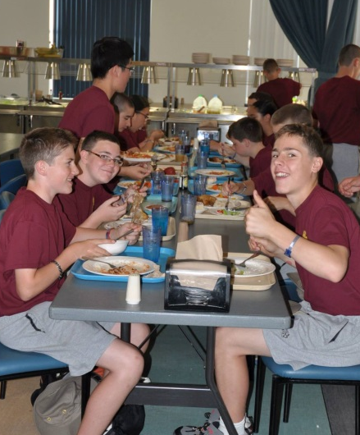

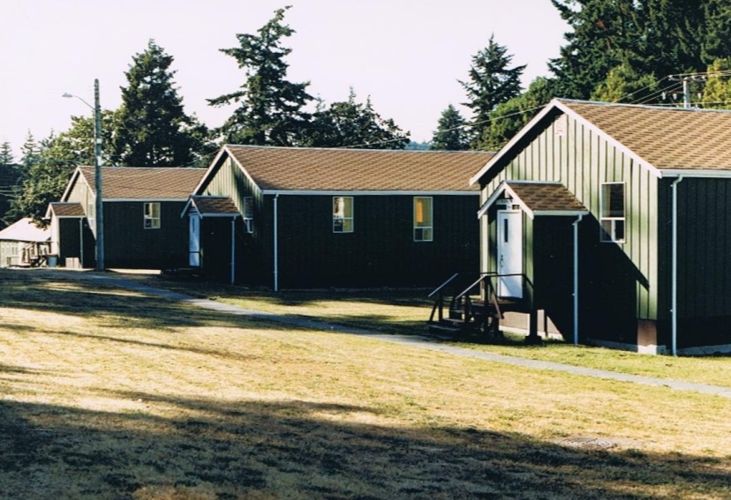
CTC Life
Accommodation & Laundry
Multi-occupant, gender specific barracks
Bunk beds
Shared washrooms
Free laundry service
Religious / Spiritual / Counselling Service
Upon request
Meals
3 meals/day
Snacks
No food in barracks
Allergies / sensitivity
  CTC can’t fully accommodate

Slide 22

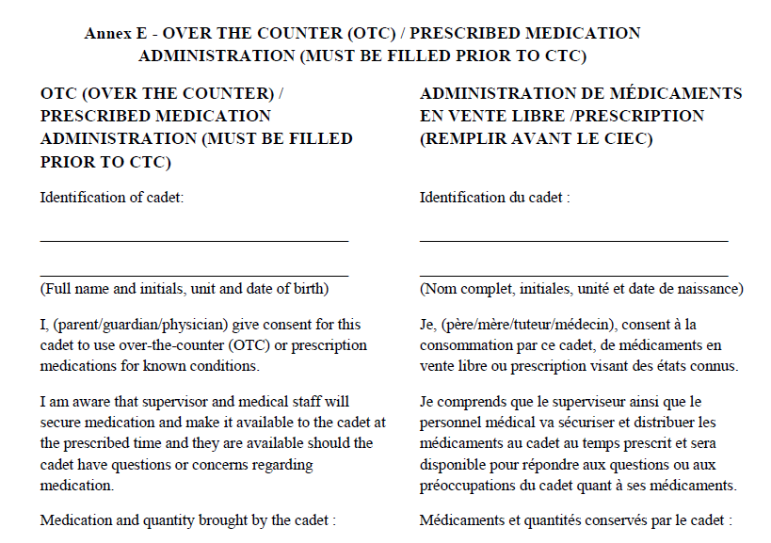
CTC Life
Medical Inspection Room (base clinic)
Medical & Dental
Return To
Unit (home)
Medication
MIR on base
Cast/Crutches -> RTU
Medically fit to attend CTC
Cadet Medical Brochure
Eyeglasses prescription
No dental service beyond emergency
Sufficient supply for entire summer
  Blister Pack highly recommended
  Expiry date
Form in JI required
OTC medication (vitamins, supplements) – do not bring
Epi Pens – 2 NON-Expired required
Medic-Alert bracelet – as needed

Slide 23
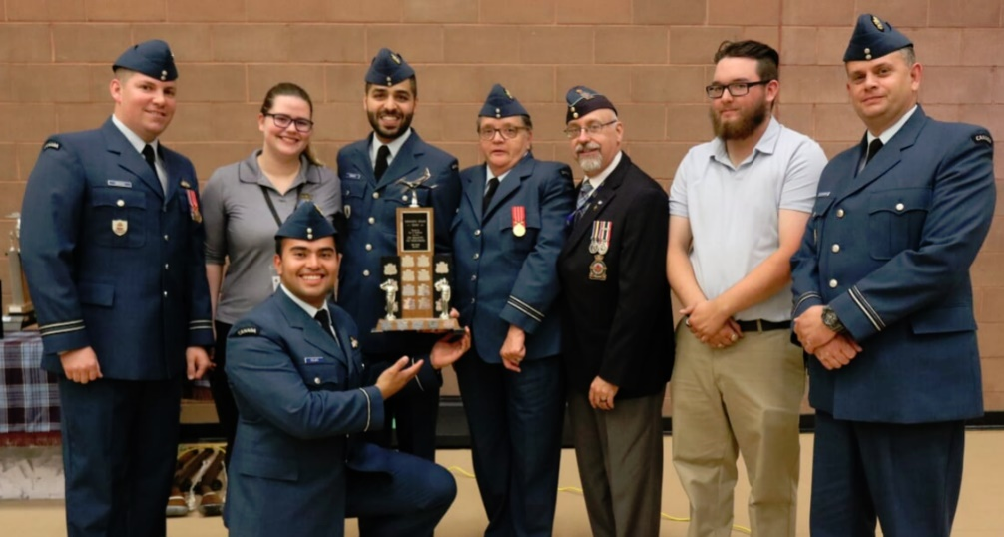
CTC Life
Supervision
Day time supervision
  Flight Staff
Night time supervision
  Training Support Staff/Officers
Time-off & Weekends
Training starts upon wake up (~0700)
Training ends after dinner (~1800)
Weekends (Sunday) & evenings off
During time off:
  Canteen, family visits, ‘homework’, socializing, uniform prep, relaxing, call home

Slide 24


CTC Life
Discipline, Smoking, Alcohol, Drugs
Zero tolerance
Other unit Cadets
Return to Unit (RTU)
What to do if in this situation
Speak to (in order):
  Flight Staff – Cadets
  Flight Staff – Officers
  CTC Counsellor / Padre
  Commanding Officer – CO@243air.com

Slide 25
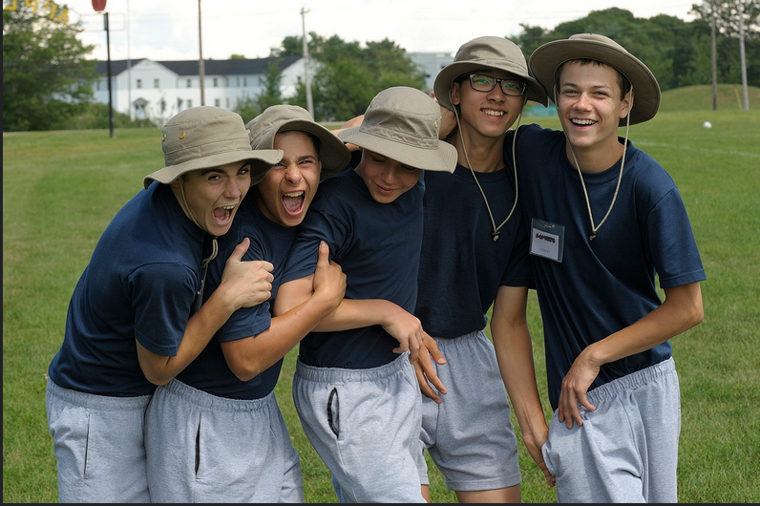
Becoming Homesick
Every Cadet gets homesick
Parents – Be strong!
  New experience
  First time away
  Support available at CTC
Cadets – Have Fun!
  Call home
  Get involved
  Make friends (shoulder flash trading)

Slide 26



Social Media
Facebook
Twitter
Instagram
@Cadets Canada
@Vernon Cadets
@HMCS Quadra Cadets
@243Air
@Cadetsca
@HMCSQuadraCdts
@VernonCadets
@Cadetsca
@243AirCadets

Slide 27


Summer Contact & Important #’s
RCSU (PAC) Movements Number
1-866-668-8388
243 Ogopogo Summer Contact Officer
Lt Rojas, D
  admino@243air.com
  250-826-7471

Slide 28


Questions?
Don’t forget to READ THE JOINING INSTRUCTIONS! * When we get them!
Take all of your forms with you!
Have a great summer!

